Slide 1
Java unit -2

Slide 2
What is an object in java?
An entity that has state and behavior is known as an object
e.g., chair, bike, marker, pen, table, car, etc.
It can be physical or logical (tangible and intangible).
The example of an intangible object is the banking system.
* Object can consume memory to hold property values.
State
Behavior
Identity

Slide 3
WHY CLASS?
PRIMITIVES
NON- PRIMITIVES

Slide 4
Class?
Class is a description of an object’s property and behavior.
A class is a group of objects which have common properties.
It is a template or blueprint from which objects are created. It is a logical entity. It can't be physical.
A class in Java can contain:
Fields
Methods
Constructors
Blocks
Nested class and interface

Slide 5
Creating an object
Length
Breadth
Height
In c++
Class name b1;
Class name *b1= new class name();
But in java b1
Class name b1= new class name();
Ex. Box b1; \\ C++
Box b1= new Box();
Length
Breadth
Height
b1

Slide 6
class Student
{
int id; //field or data member or instance variable
String name;
//creating main method inside the Student class
public static void main(String args[])
{
Student s1=new Student(); //creating an object of Student
//Printing values of the object
System.out.println(s1.id); //accessing member through reference variable
System.out.println(s1.name);
}
}

Slide 7
Ways to initialize object in java
There are 3 ways to initialize object in Java.
By reference variable
By method
By constructor

Slide 8
Initialization through reference
class Student
{
int id;
String name;
}
class TestStudent2
{
public static void main(String args[])
{
Student s1=new Student();
s1.id=200;
s1.name=“IITM";
System.out.println(s1.id+" "+s1.name); //printing members with a white space
}
}

Slide 9
class Student{
int id;
String name;
}
class TestStudent3{
public static void main(String args[])
{ //Creating objects
Student s1=new Student();
Student s2=new Student();
//Initializing objects
s1.id=200;
s1.name=“IITM";
s2.id=501;
s2.name="Amit";
//Printing data
System.out.println(s1.id+" "+s1.name);
System.out.println(s2.id+" "+s2.name);
}
}

Slide 10
Initialization through
class Student {
int rollno;
String name;
void insertRecord(int r, String n) {
rollno=r;
name=n; }
void displayInformation(){
System.out.println(rollno+" "+name); }
}
class TestStudent4{
public static void main(String args[]){
Student s1=new Student();
Student s2=new Student();
s1.insertRecord(111,"Karan");
s2.insertRecord(222,"Aryan");
s1.displayInformation();
s2.displayInformation();
}
}

Slide 11
Real World Example: Account
class Account{
int acc_no;
String name;
float amount;
//Method to initialize object
void insert(int a,String n,float amt){
acc_no=a;
name=n;
amount=amt;
}
//deposit method
void deposit(float amt){
amount=amount+amt;
System.out.println(amt+" deposited");
}

Slide 12
//withdraw method
void withdraw(float amt){
if(amount<amt){
System.out.println("Insufficient Balance");
}else{
amount=amount-amt;
System.out.println(amt+" withdrawn");
}
}
//method to check the balance of the account
void checkBalance(){System.out.println("Balance is: "+amount);}
//method to display the values of an object
void display(){System.out.println(acc_no+" "+name+" "+amount);}
}

Slide 13
//Creating a test class to deposit and withdraw amount
class TestAccount {
public static void main(String[] args) {
Account a1=new Account();
a1.insert(832345,"Ankit",1000);
a1.display();
a1.checkBalance();
a1.deposit(40000);
a1.checkBalance();
a1.withdraw(15000);
a1.checkBalance();
}}

Slide 14
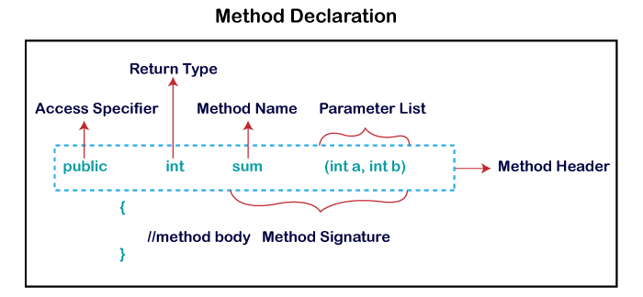
Methods
A method is a block of code or collection of statements or a set of code grouped together to perform a certain task or operation. It is used to achieve the reusability of code.
Method Declaration
The method declaration provides information about method attributes, such as visibility, return-type, name, and arguments.

Slide 15
Access Specifier
Public: The method is accessible by all classes when we use public specifier in our application.
Private: When we use a private access specifier, the method is accessible only in the classes in which it is defined.
Protected: When we use protected access specifier, the method is accessible within the same package or subclasses in a different package.
Default: When we do not use any access specifier in the method declaration, Java uses default access specifier by default. It is visible only from the same package only.

Slide 16
Naming a Method
While defining a method, remember that the method name must be a verb and start with a lowercase letter.
If the method name has more than two words, the first name must be a verb followed by adjective or noun. In the multi-word method name, the first letter of each word must be in uppercase except the first word.
For example:
Single-word method name: sum(), area()
Multi-word method name: areaOfCircle(), stringComparision()

Slide 17
Create a user defined method
public static void findEvenOdd(int num)
{
//method body
if(num%2==0)
System.out.println(num+" is even");
else
System.out.println(num+" is odd");
}

Slide 18
Invoke or calling a method
import java.util.Scanner;
public class EvenOdd
{
public static void main (String args[])
{
//creating Scanner class object
Scanner scan=new Scanner(System.in);
System.out.print("Enter the number: ");
//reading value from the user
int num=scan.nextInt();
//method calling
findEvenOdd(num);
}

Slide 19
Static Keyword
The static keyword in Java is used for memory management mainly. We can apply static keyword with variables, methods, blocks and nested classes. The static keyword belongs to the class than an instance of the class.
Variable (also known as a class variable)
Method (also known as a class method)
Block
Nested class

Slide 20
Java static variable
used to refer common Properties ,
for example, the company name of employees, college name of students, etc.
The static variable gets memory only once in the class area at the time of class loading.
class Student
{
int rollno;
String name;
String college="IITM";
}

Slide 21
class Student{
int rollno;//instance variable
String name;
static String college ="IITM";//static variable
//constructor
Student(int r, String n){
rollno = r;
name = n;
}
//method to display the values
void display ()
{
System.out.println(rollno+" "+name+" "+college);}
}

Slide 22
public class TestStaticVariable1{
public static void main(String args[])
{
Student s1 = new Student(110,“Aman");
Student s2 = new Student(222,"Arya");
//we can change the college of all objects by the single line of code
//Student.college=“IITM";
s1.display();
s2.display();
}
}

